Slide 1
EPICS and Software
K. Alexander Fahey
LLRF Electrical Engineer
EIC LLRF Controls-ASR-PDR2
April 21st & 22nd, 2026

Slide 2
Charge Questions
Have the committee recommendations from the Preliminary Design Review been addressed adequately?
Are the system requirements sufficiently defined, understood, and documented for this phase of the design?
Do the designs meet the requirements?
Are the interfaces sufficiently defined, understood and documented for this phase of the design?
Are the analysis, simulations, drawings and specifications, and work plans, sufficient for this phase of the design?
Are the plans to address ES&H and quality sufficient for this phase of the design?
Have technical risks been identified and are mitigation plans adequate for this phase of the design?
Is the overall design maturity sufficient to proceed with the final design phase?

Slide 3
Recommendations and Comments Addressed
Charge #1
EIC # | Recommendation | Action Taken
1049 | Provide a complete hardware, firmware, and software test suite to support development and testing across all aspects of RF System development | Designs for daughtercard, interfaces, and EPICS IOC tracked on EIC GitHub
1051 | Embed software engineer/s in the RF Systems development team to begin developing EPICS IOCs and tools for RF System Controls, and data migration from the LLRF application to the IOC | An electrical engineer in RF Controls has made progress on developing IOCs for RF System Controls
# | Comment | Action Taken
8 | An EPICS software engineer should be identified as soon as possible | An EPICS software engineer is developing IOCs for RF System Controls

Slide 4
Outline
Scope
Design Flow
Technical Progress
Software Block Diagram
EPICS Lessons Learned
QC Plan
Path Forward
Summary

Slide 5
Software Scope
Charge #2, 4
EPICS uses IOCs (Input-Output Controllers) to modify device parameters
Controls WBS provides EIC groups with baseline environments
We need to develop IOCs for the devices we deploy
Certain software functions will be migrated between RHIC and EIC
Would be inefficient to re-invent the wheel with these algorithms

Slide 6
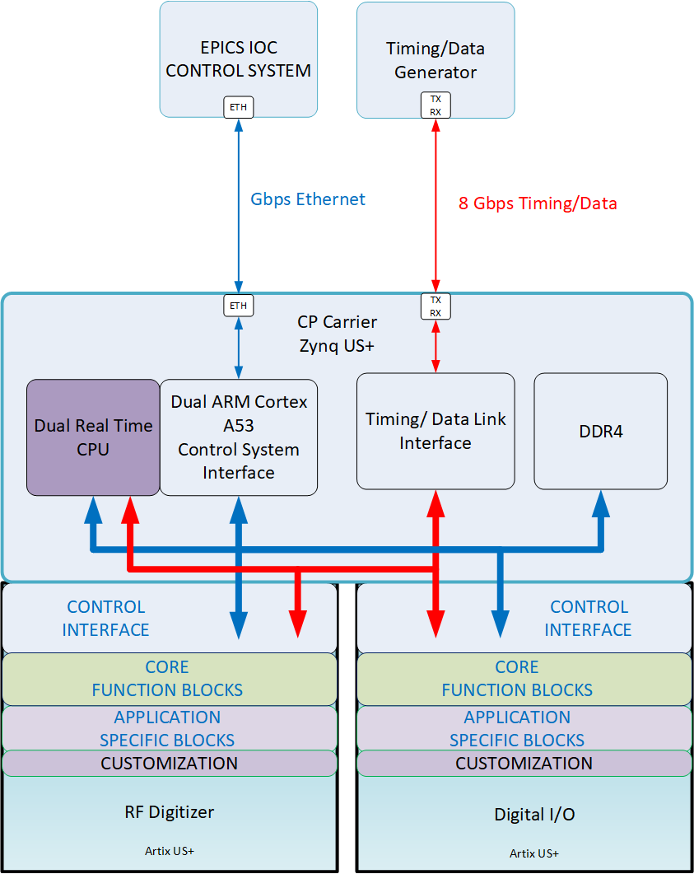
Common Platform
Charge #4
EPICS IOC Control
Packets generated and interpreted by PscDrv on A53 core
Timing/Data Link
Inputs
Machine parameters
Cavity voltages & status
Ring h=1 NCO phases
Beam measurements (radius, etc.)
Outputs
f_{rev} FTW
Ref NCO phases
System events/triggers
Real-time CPUs
Beam control loops
Output f_{rev}, φ_{s}
Ring2ring synchro/cogging
Injection cogging
Beam permit high-level logic
FPGA core & application blocks
NCO/DDS with soft reset
Digital down converter
Cavity vector sum calc
Beam sync event generator
Beam permit logic
RF signals
Inputs
Beam phase
Reference line
Outputs
Reference line drive
Debug / monitoring
Digital signals
Outputs
Beam permit status
Debug / monitoring triggers
Debug / monitoring status

Slide 7
Design Flow – Vitis
Charge #1, 2, 4
FWFWK Workflow
Git tracking, scripts for compilation
Automatically pulls in bitstream from hardware project
Compiler environment can be scripted
Adding specific libraries
Defining target CPU
Defining environment variables
Binary files are automatically created and exported
No need for Vitis GUI
DesyRDL generates headers for EPICS functionality
Defined through configurable jinja2 templates
Current template automates PSCDrv PVs
[TALK #10 Mai]

Slide 8
Design Flow – EPICS
Charge #1, 2, 4
EIC Requires EPICS
Migrating from current ADO framework
Open-Source
Large Install Base
PSCDrv - Advantages
Portable Streaming Controller Driver
Carrier to Remote IOC communication
Lower overhead on carrier than running full IOC
Carrier does not need specific firmware to handle each daughtercard
IOC VMs
Running common EPICS binary on a shared drive
[TALK #6 Mernick]
Notes:
Carrier does not need specific software
Requ

Slide 9
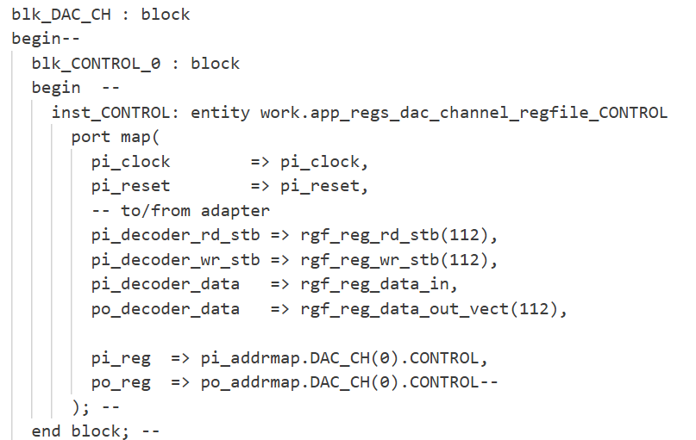
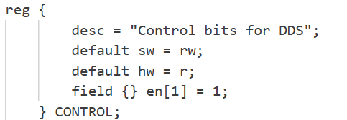
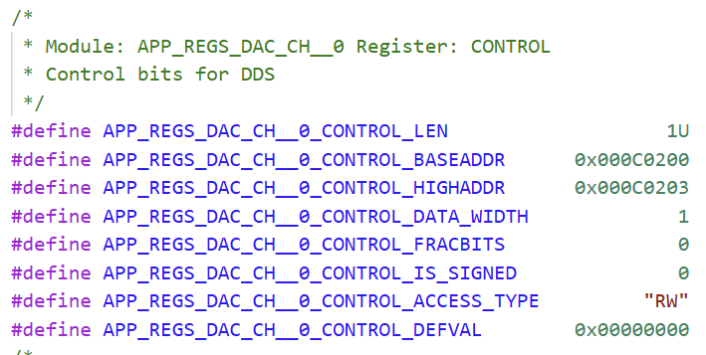
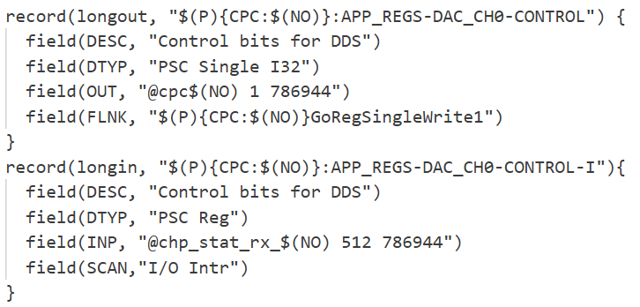
Design Flow – DesyRDL Templates
Charge #1, 2, 4
Jinja2 template structure
Automates file creation
Takes in RDL Parameters
Outputs mapped registers
Several filetypes built-in
Vivado AXI mapping
Vitis C header
Can create custom filetypes
EPICS .db file
Hooks into DESY FWFWK
Registers do not need to be manually updated to be controlled by PscDrv
Integrates into AXI Chip2Chip
Carrier can read and write data in these defined registers
RDL Register
VHDL Block
C Header
EPICS PV
Notes:
Add DesyRDL to

Slide 10
Design Flow – Build Environment
Charge #2
Virtual Machine (VM) Based
Remotely controlled over EIC network
Provided by Controls Group
VMs configured for FWFWK compilation
VMs configured for EPICS IOC compilation
Remote JTAG Debug
Physical machine access not required for debugging
Standardized Workflow
All processing is remote
Local machines not required to run Linux (FWFWK requirement)

Slide 11
Software Block Diagram

Slide 12
Technical Progress – Algorithm Porting
Charge #1, 2, 5
Program DSP core ported from RHIC Virtex-5 to R5 core of EIC CP Carrier
Calculates revolution frequency from ADO beam parameters and Update Link beam status
ADO parameters moved to EPICS PSCDrv parameters
EPICS IOC running on remote VM
Live run data pulled from RHIC Update Link during final run
Running calculations matched current and historical data
Notes:
Details of Program DSP

Slide 13
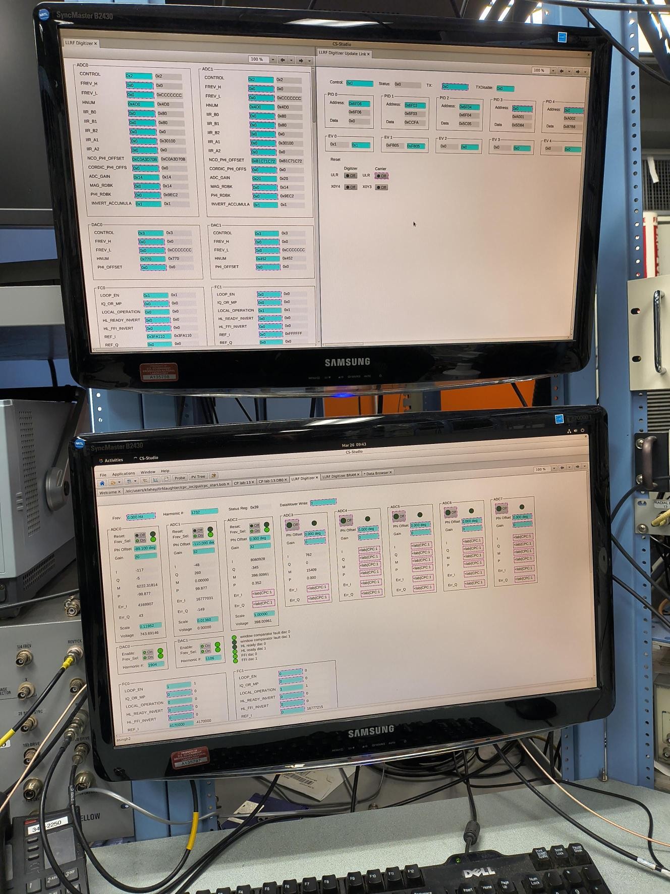
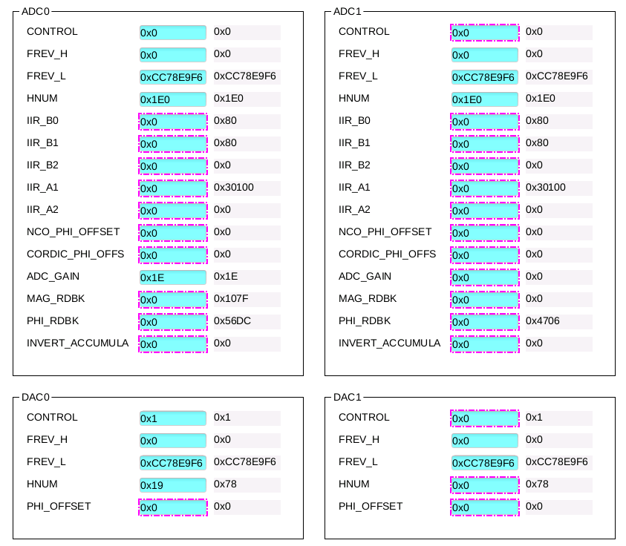
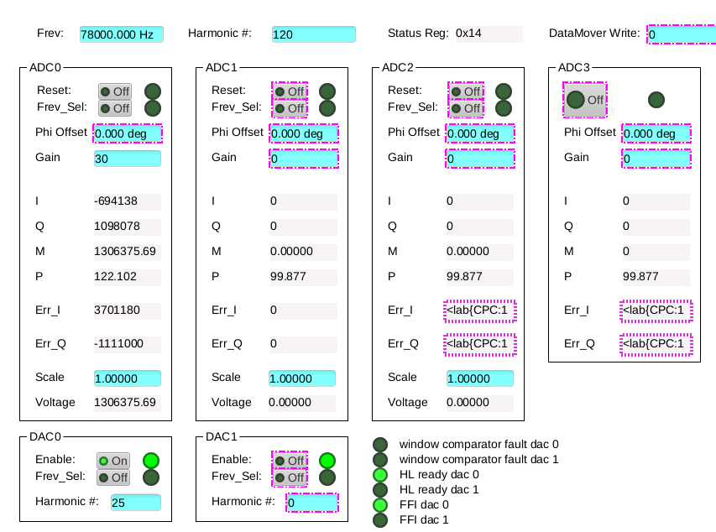
Technical Progress – LLRF Digitizer
Charge #1, 2, 5
Remote IOC Controlling LLRF Digitizer
PscDrv packets between CPC and IOC
CPC reads/writes from shared memory
Phoebus UI for IOC
Generic get/set UI (top)
Formatted controller UI (bottom)
Notes:
Put length of test

Slide 14
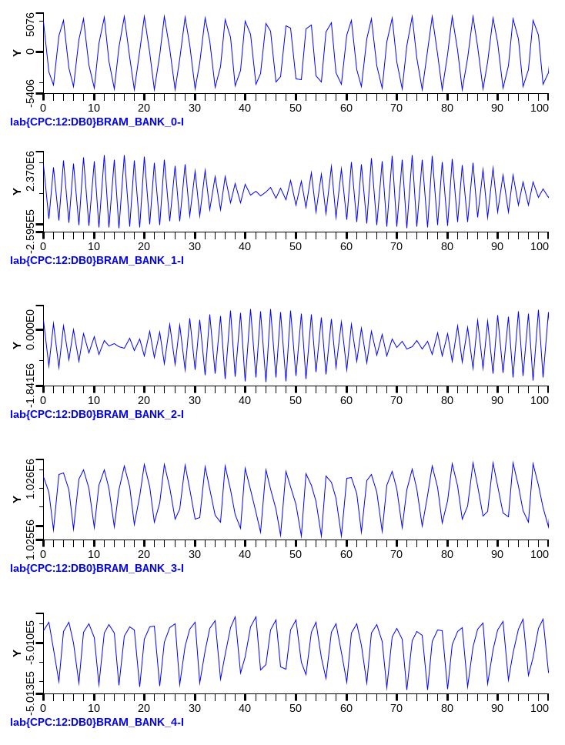
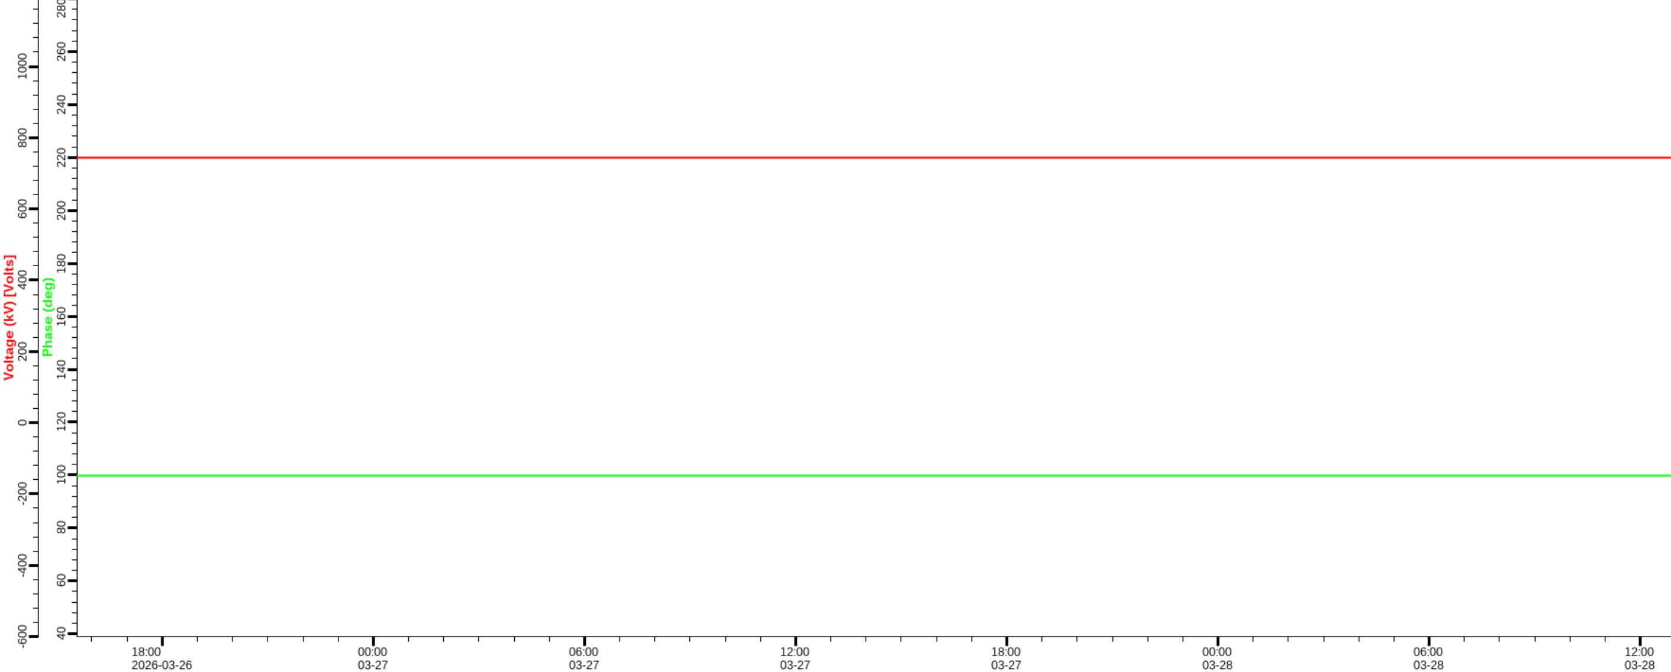
Technical Progress – LLRF Digitizer
Charge #1, 2, 5
24.6MHz Loopback
Successfully Logged Digitizer Readback PVs
Entire Test data captured
March 10-24, 2026
Both slow data and snapshot data are logged
Raw Data
CP LLRF Test with RHIC 197 MHz Cavity
I
Cavity Voltage (~ 220 kV)
Q
Cavity Phase (100 degrees)
IQ After Low-Pass Filter

Slide 15
EPICS Lessons Learned
Charge #1, 2, 6
Large number of resources available for learning
USPAS courses readily available
Scripting PVs for large register maps important
Changes to map can shift many addresses
Manually shifting PV addresses tedious and time-consuming
[TALK #6 Mernick]
Notes:
EPICS is well documented
Grammar of second bullet point

Slide 16
QC Plan
Charge #1, 6
Developing on local copy of IOC
Confirming PVs work as expected before uploading to IOC server
EPICS is verbose with PV errors
Confirming Phoebus UI looks as expected
Git tracked IOC changes
Significant changes can be monitored
IOC revision can be rolled back for older digitizer firmware

Slide 17
Path Forward and Summary
Charge #8
Path Forward
We are continuing to test the digitizer on a test setup in LLRF lab
Modifications to the IOC are being made to add required EPICS modules from Controls
Work is being done to port more LLRF algorithms for tests in RF Test Facility
We have made significant progress in EPICS development
LLRF Digitizer is EPICS controlled
We are migrating RHIC algorithms to Common Platform
Program DSP has been migrated to Common Platform
We are ready to support an EPICS-controlled EIC, using Common Platform hardware
Questions?
Notes:
Bring waveform to digitizer

